Slide 1

Presentation Materials Created by Mimetics Inc.
Free use by anyone for non-commercial purposes
Copyrights, Trademarks and other Registered Marks the Property of their Owners

Slide 2
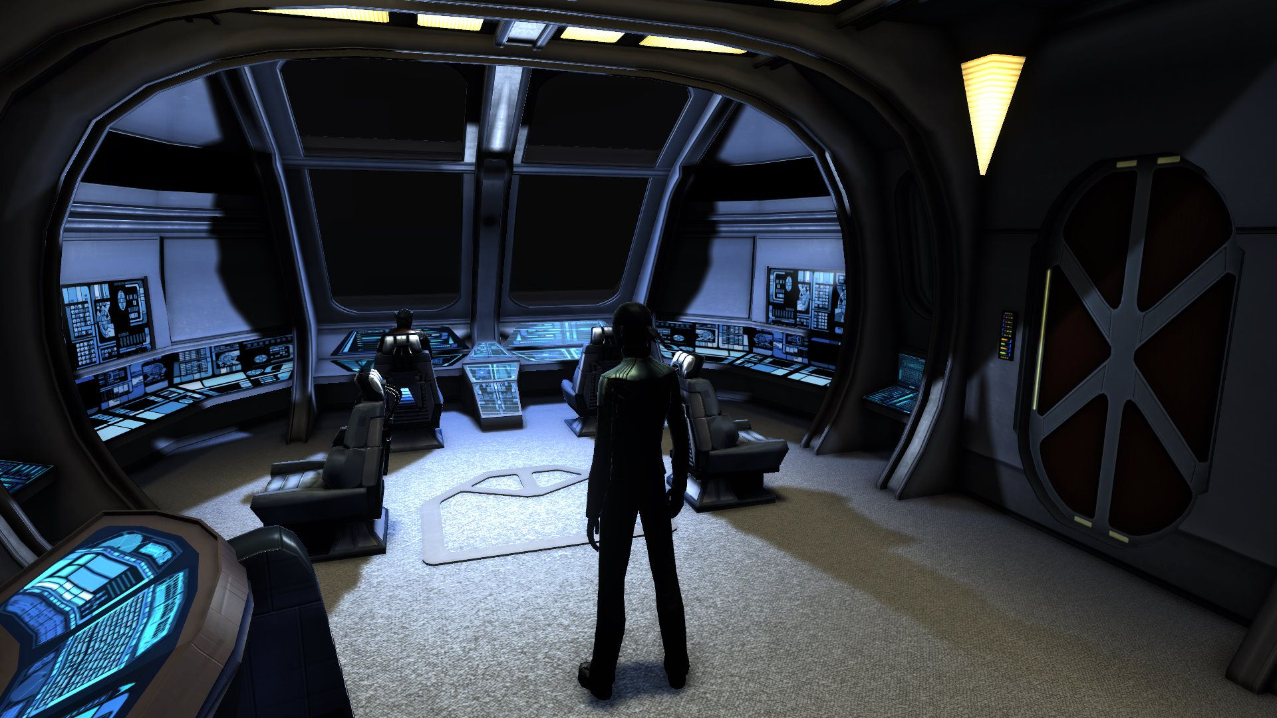
The Expected ISS Interior

Slide 3
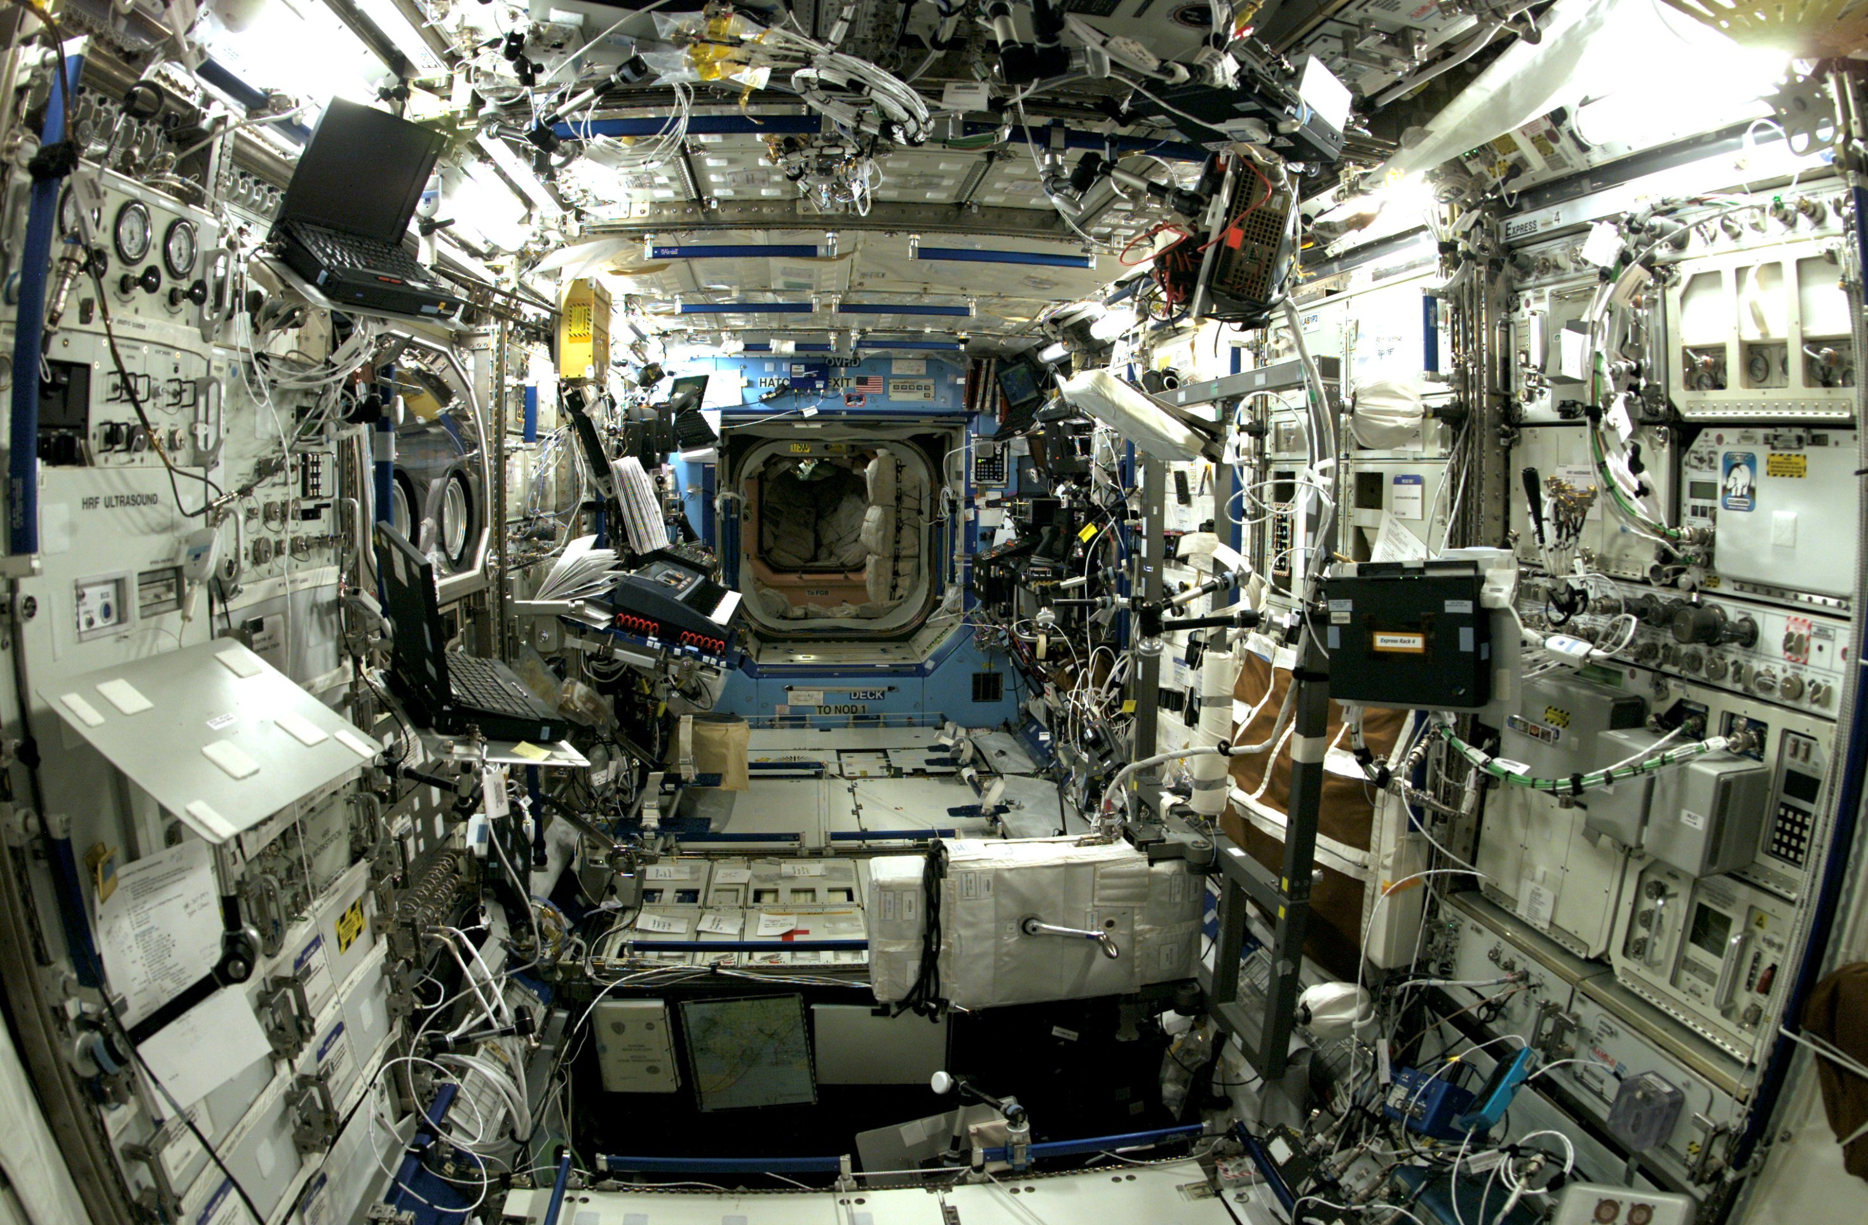
The Actual ISS Interior

Slide 4
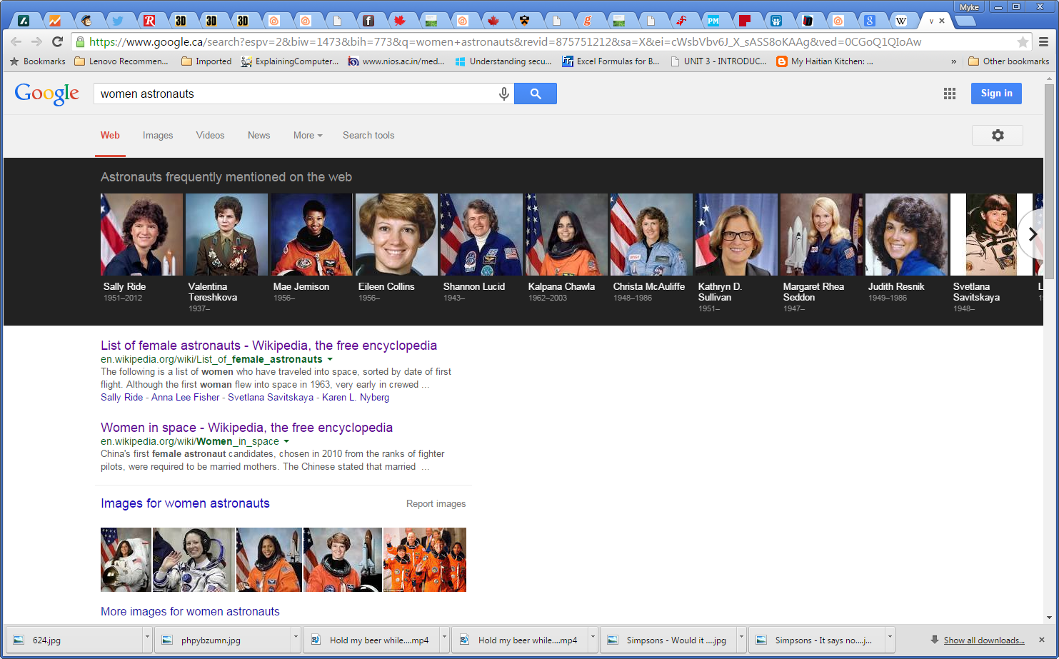
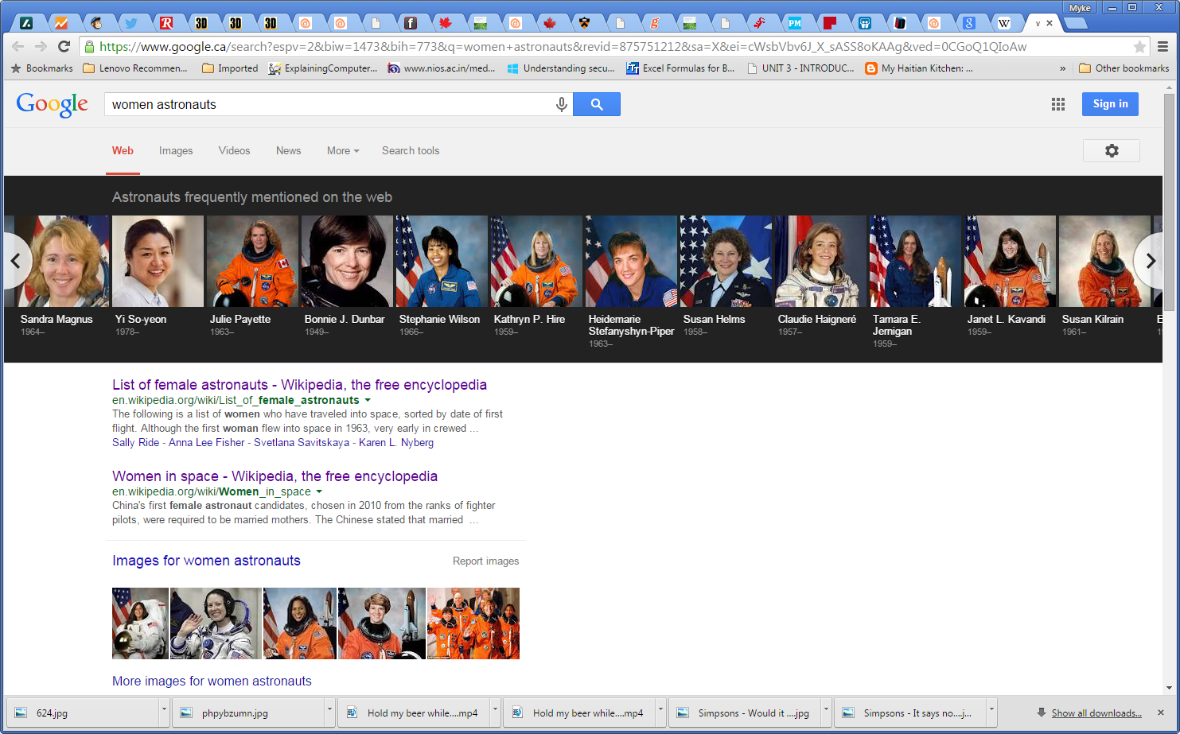
Women in Space
59 Women Astronauts (out of 536 Total)
2 Canadian Women Astronauts (Bondar & Payette)

Slide 5
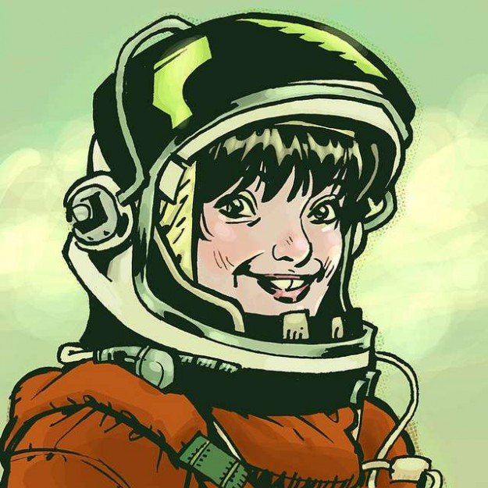
What Makes A Person an Astronaut?

Slide 6
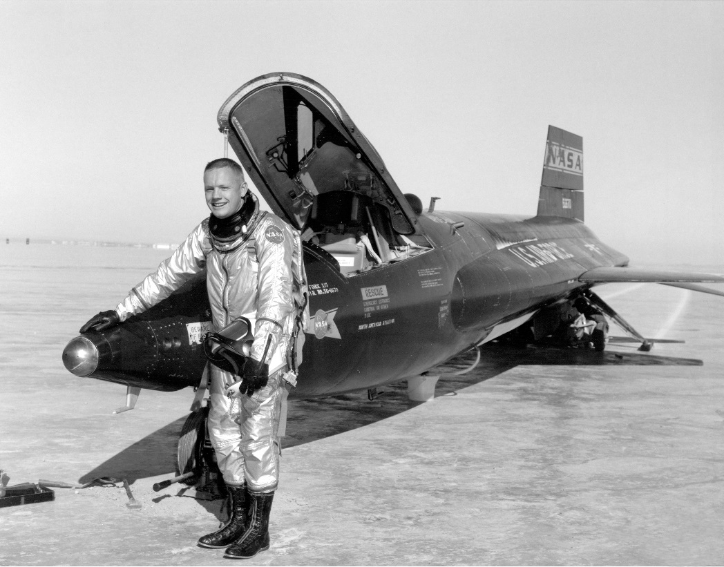
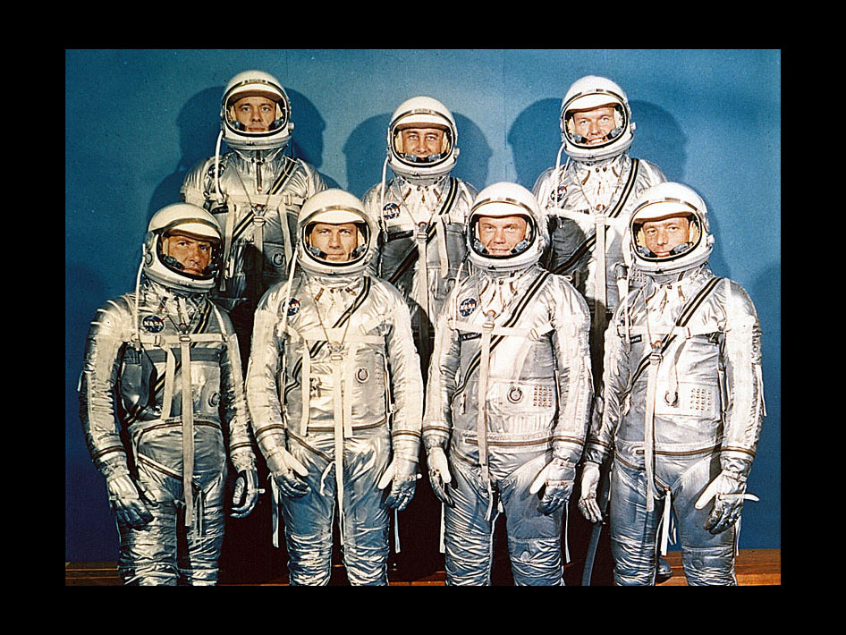
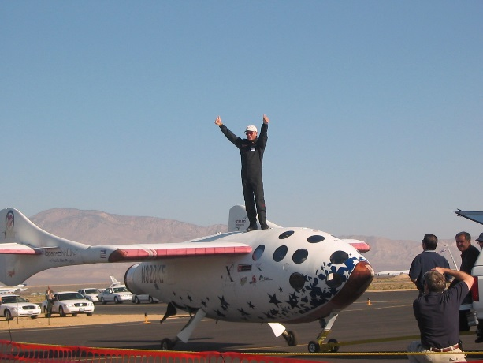
What Makes A Person an Astronaut?
Flying > 50km Above the Earth

Slide 7
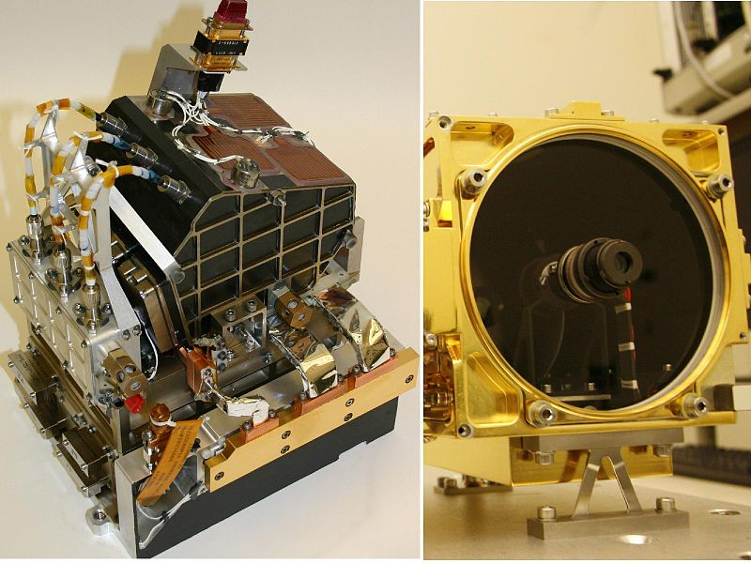
Instruments Used in Space

Slide 8
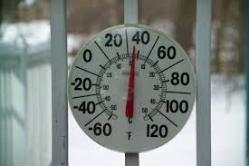
Suffix “ometer” – means “Meter”
Speedometer measures speed in a car
Thermometer measures temperature
Hygrometer measures humidity
Tachometer measures rotational speed
Sphygmomanometer measures blood pressure
What other “ometers” are there?

Slide 9
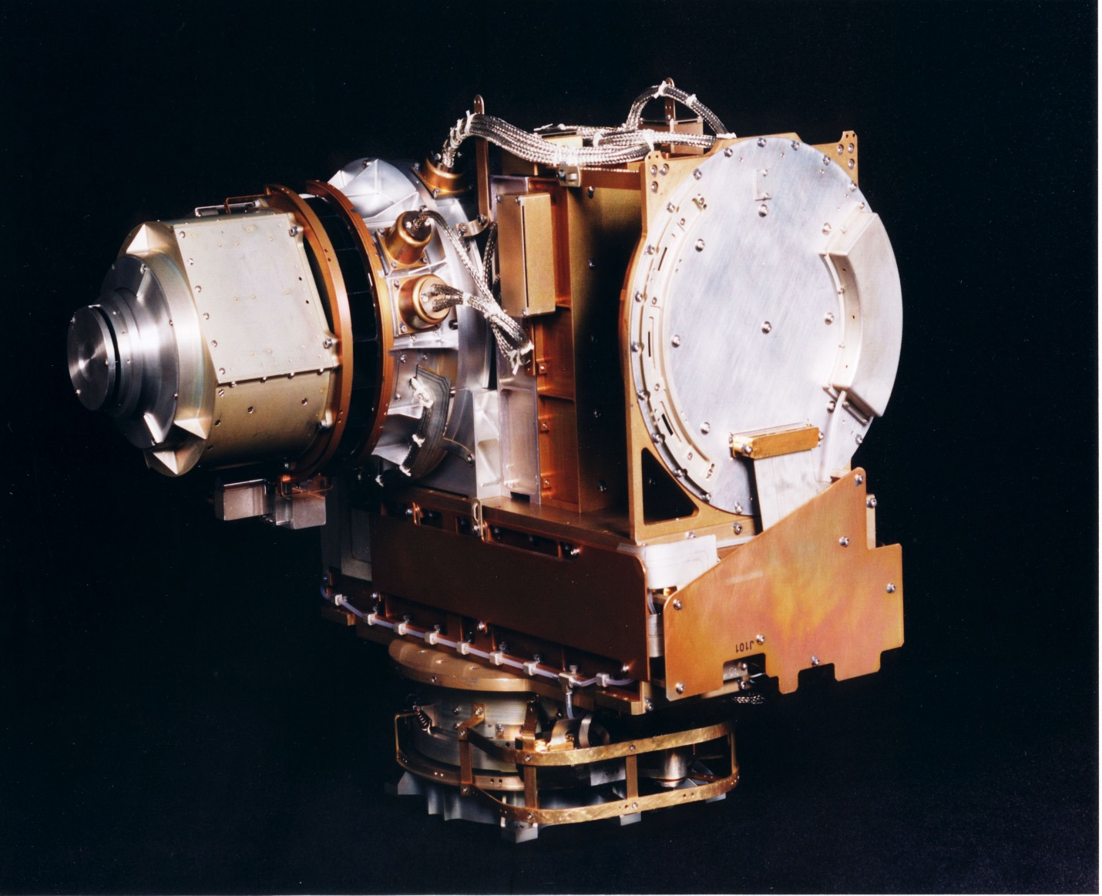
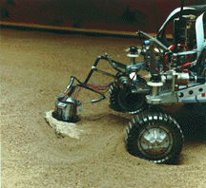
Common Instruments used In Space

Slide 10
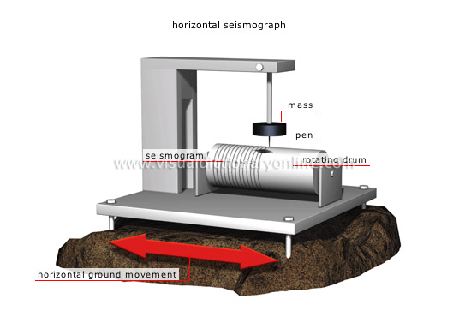
Seismometer
Measures vibrations in a planet’s surface
Is this used in an orbiting platform?
How many are typically used?

Slide 11
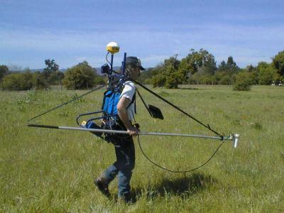
Magnetometers
Alpha magnetic spectrometer.
What is it used for?

Slide 12
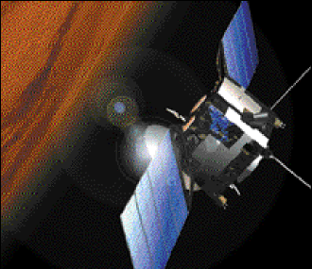
Retro Reflectors
Retro reflectors on the Mars Express.
Retro Reflectors bounce a laser beam off a planet to determine height above the planet.
How would it measure the height?

Slide 13
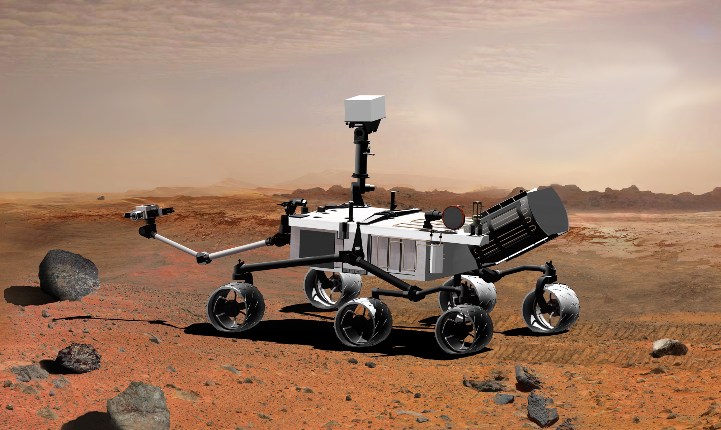
Spectrometers
Spectrometers measure the Interaction between Matter and Energy
How do they work?

Slide 14
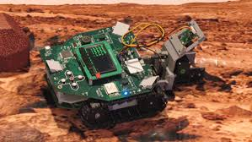
Using the Spectrometer on the Jade Robot
How does the spectrometer work in Jade?

Slide 15
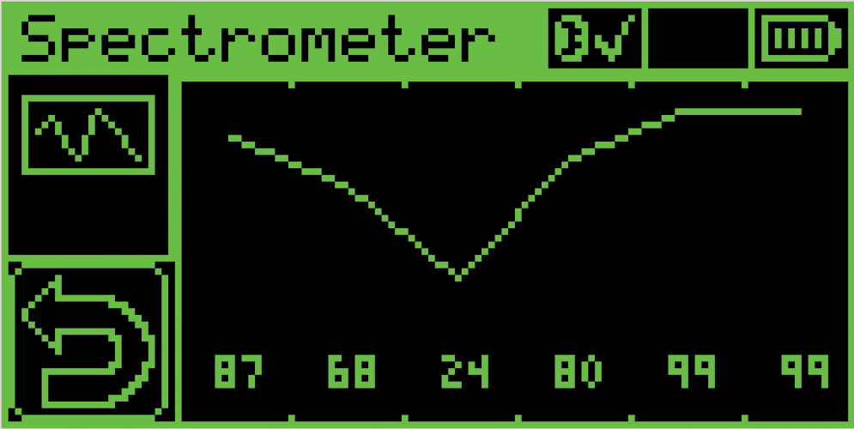
Using the Jade Spectrometer

Slide 16
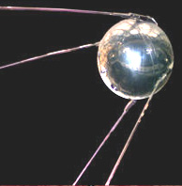
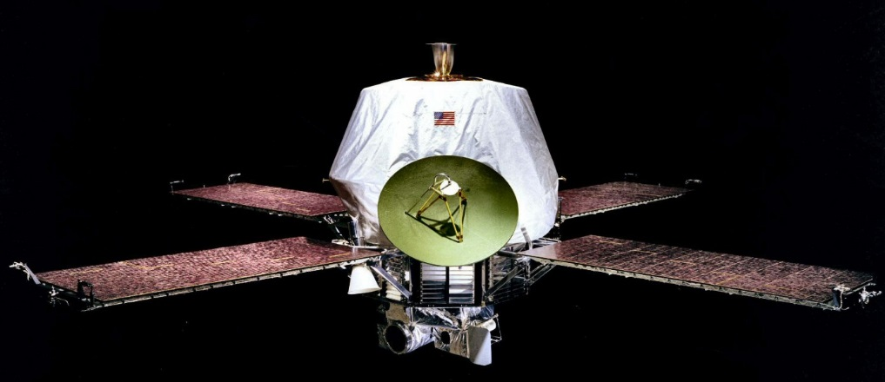
Space Probes
Sputnik was the first in space.
Mariner 9 was one of the first to explore Mars.

